Slide 1




RUBUCKS
Coffee Sales Report
Presented By:
MiruthulaVishnavy S

Slide 2


Problem Statement
The goal is to forecast monthly coffee sales using past transaction data.
This helps optimize inventory purchasing, staffing levels, and revenue planning.
Coffee sales fluctuate due to seasonal demand, holidays, and promotions - understanding these patterns ensures consistent supply and reduced wastage.

Slide 3



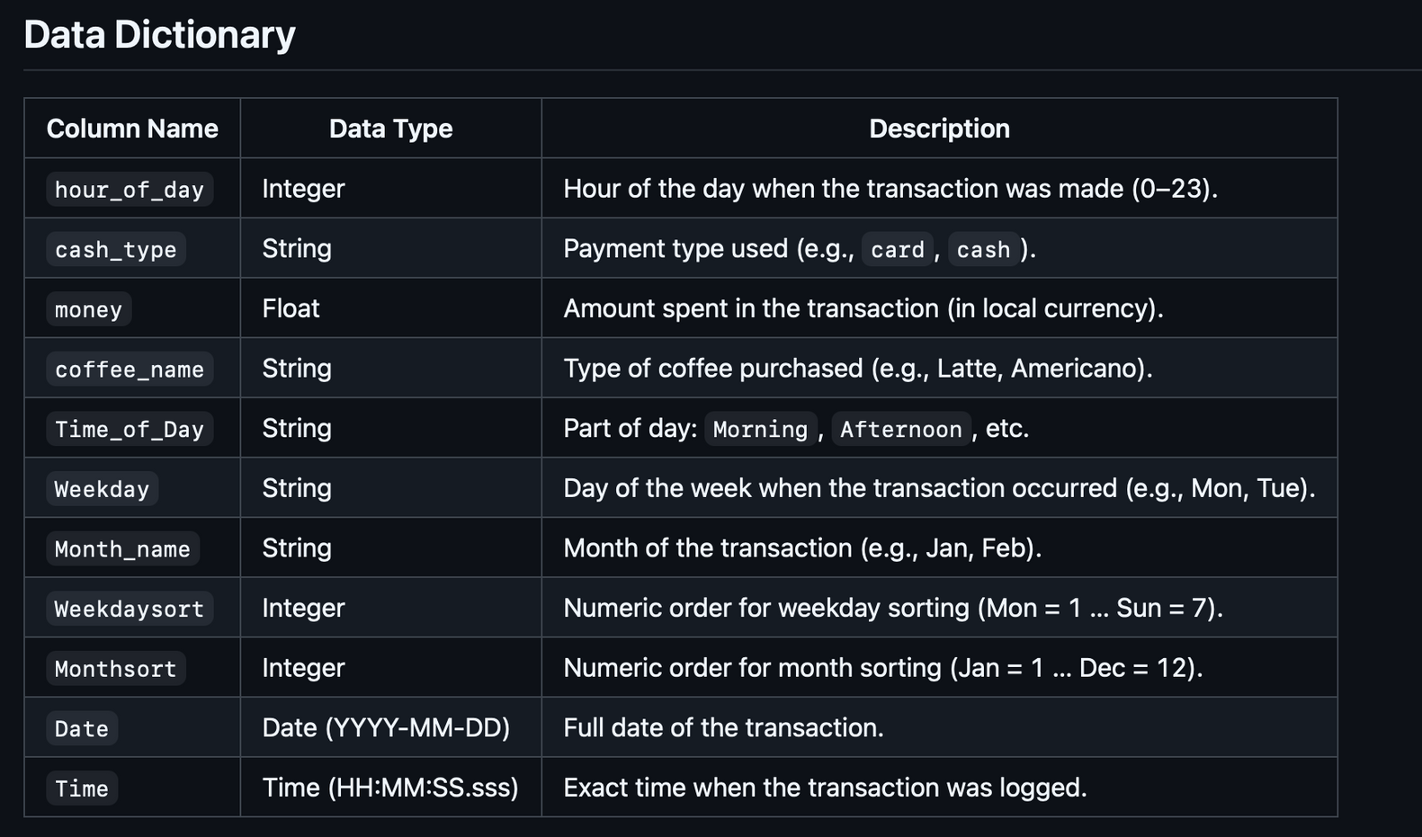

Data Overview
Dataset: Coffe_sales.csv (daily data aggregated into monthly totals).
Period: 2024 - 2025
Source: Point-of-Sale (POS) system, reliable and internally verified.
Missing values were replaced with zeros to maintain time continuity.

Slide 4



Methodology
Models Evaluated | Captures Seasonality | RMSE | Captures Trend
SES |  | $320
Seasonal Naive (SNAIVE) |  | $250
Holt-Winters |  | $160

Slide 5


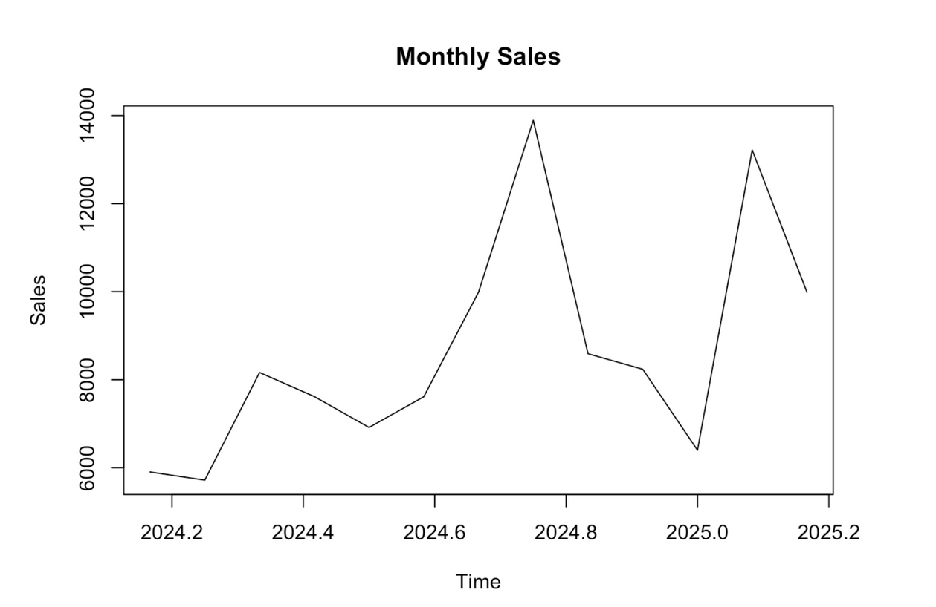




Exploratory Analysis
Monthly sales show a steady upward trend with noticeable seasonal peaks.
Spikes during festive months (e.g., December, summer promotions).
Autocorrelation Function (ACF) reveals a repeating cycle around every 12 months.
Indicates strong yearly seasonality.

Slide 6

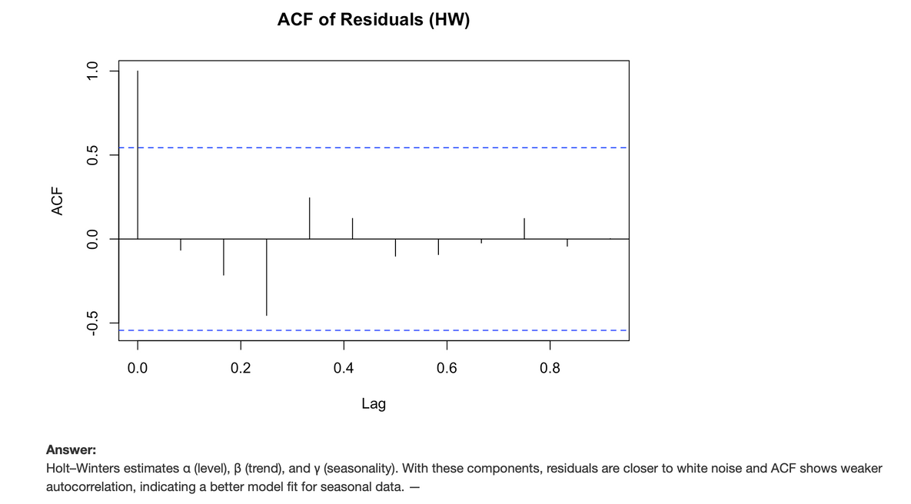

Model Judgement & Residual Analysis
Residual analysis shows:
No autocorrelation (ACF of residuals flat).
Mean residual = 0 -> unbiased forecast.
Constant variance and normally distributed errors.

Slide 7
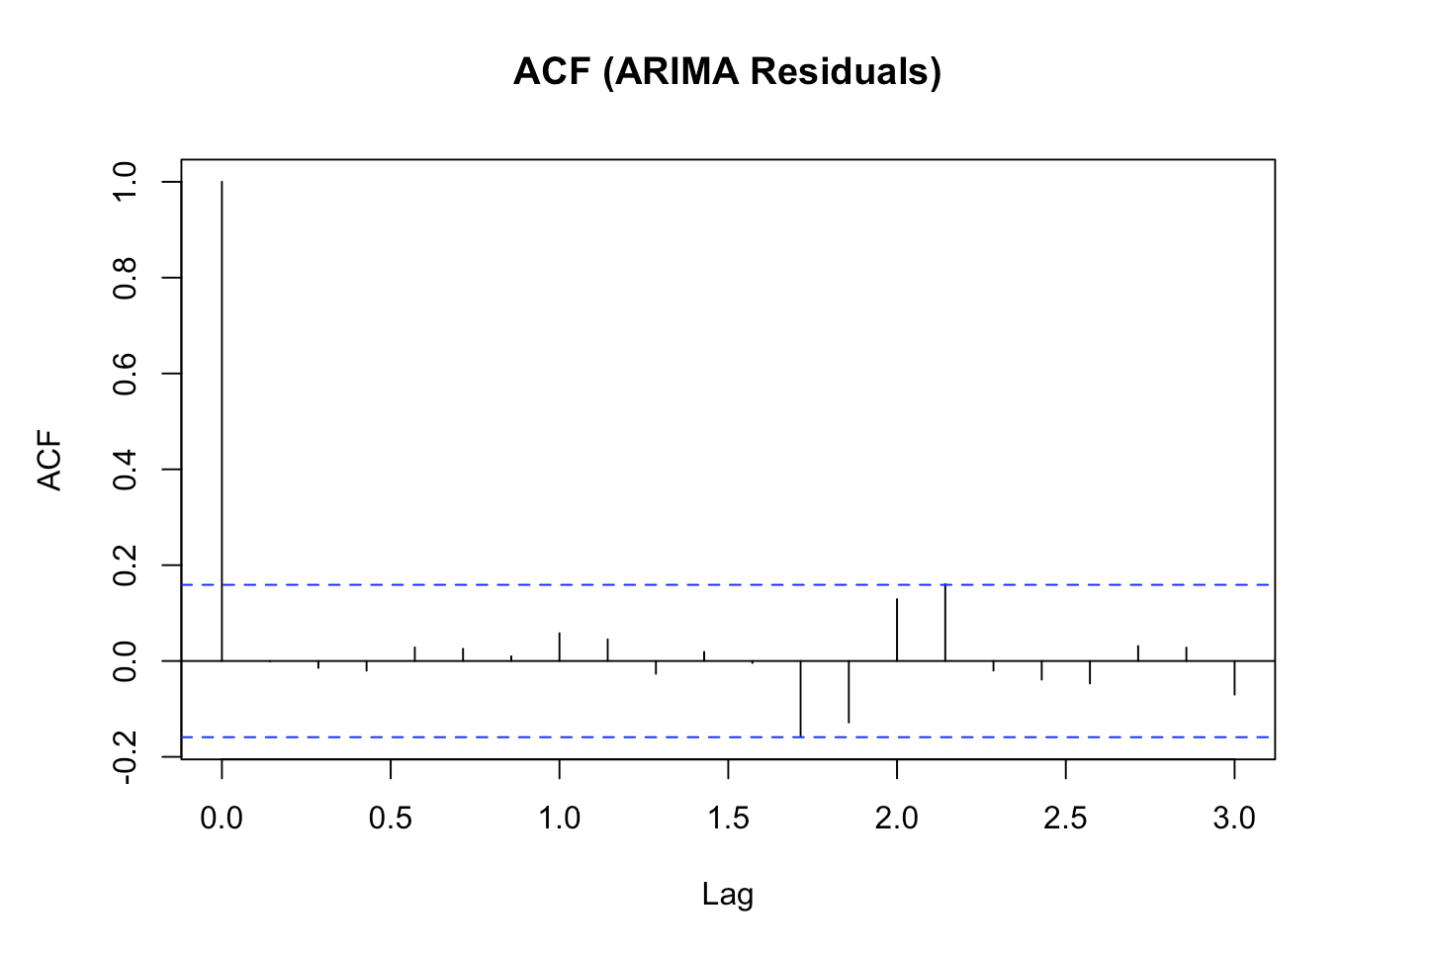
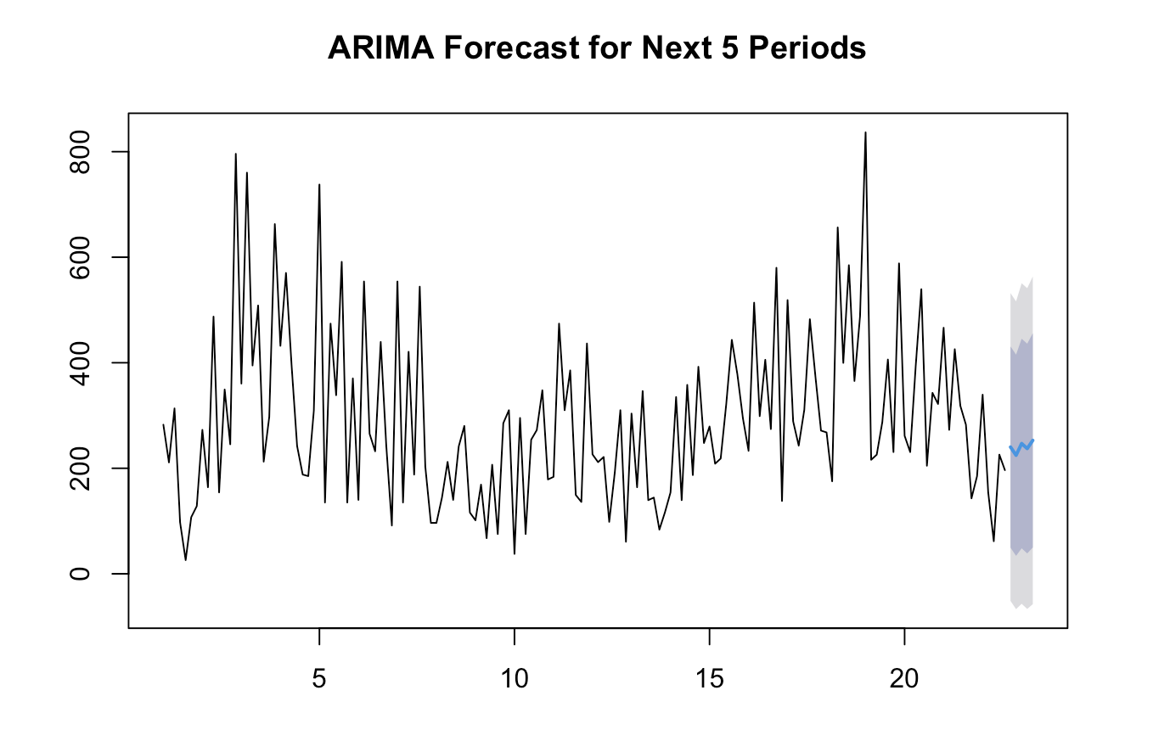
ARIMA Model
(Auto Regressive Integrated Moving Average)
Captures trend and autocorrelation in the data
Suitable for non-seasonal or weakly seasonal data
How ARIMA performed on Coffee Sales:
Detects short-term patterns in spikes
Handles noise moderately well
RMSE is better than SES but worse than Holt-Winters
Does not fully capture seasonality → seasonal peaks remain unexplained

Slide 8

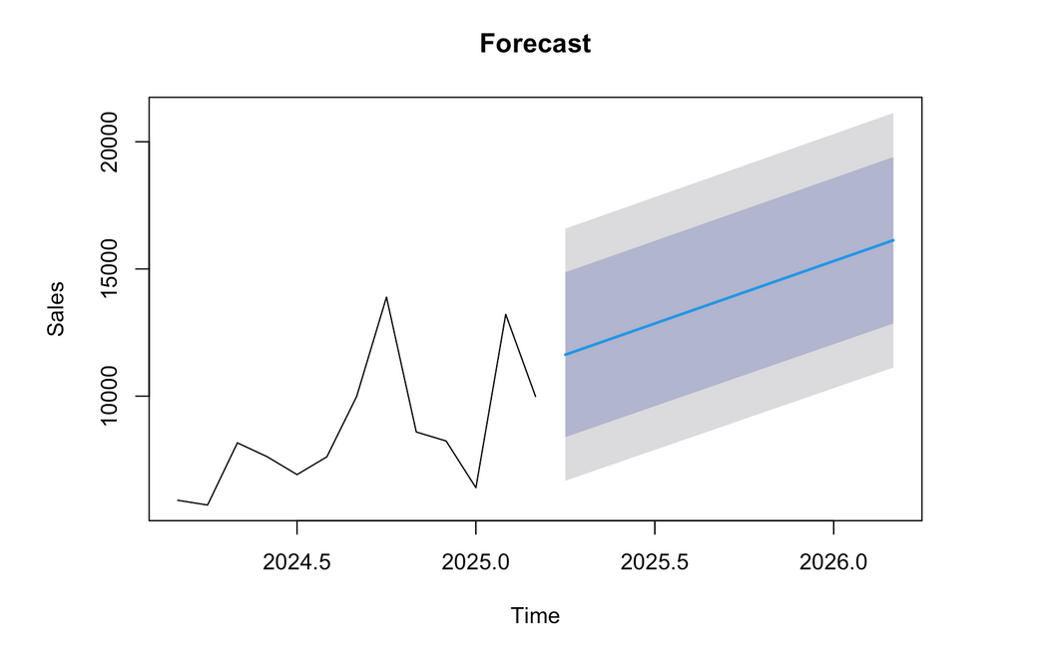
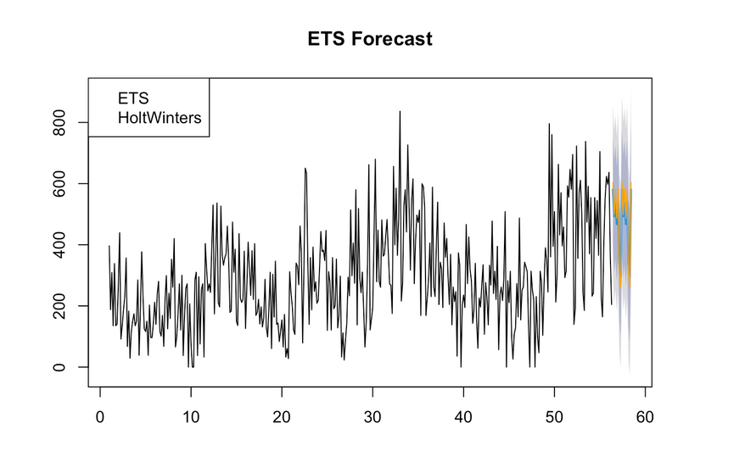

Forecast and Conclusion
Implication:
Expect 8–10% sales growth over the next half-year.
Management can plan bean orders, staff shifts, and promotional inventory accordingly.

Slide 9

Final Recommendation
Chosen Model: Holt-Winters Additive Seasonal.
Why:
Lowest RMSE.
Accurately captures both trend and seasonality.
Stable forecasts and interpretable components (level, trend, season).
Assumptions: Seasonality pattern remains consistent over time.

Slide 10



Future Improvements
Incorporate external regressors like weather, holidays, and promotions.
Apply hierarchical forecasting for product categories.
Use machine learning model (e.g., ARIMA) for comparison.
Re-train model monthly as new data is recorded.

Slide 11
Thank You

